Slide 1

Global AI Regulation Briefing (2016–2025)
An introduction to the key developments in AI regulation across the United States, European Union, United Kingdom, and China from 2016 to 2025.

Slide 2
Regulatory Timeline (2016–2025)
2023
2016
2021
US issues Executive Order 14110, mandating AI model safety testing and reporting
EU adopts GDPR, establishing privacy and data governance for AI
EU proposes AI Act, introducing a risk-based regulatory framework
2022
China releases Algorithm Recommendation Provisions for algorithmic transparency
2024
2019
EU adopts AI Act, with phased implementation of requirements through 2026
EU High-Level Expert Group publishes AI Ethics Guidelines

Slide 3








Comparison Matrix
Percentage of regulatory requirements implemented across key areas
85%
75%
60%
90%
Scope and Approach
Risk Tiers
Prohibited Uses
Enforcement

Slide 4
Obligations by Role
Developer/Provider Obligations
Develop Quality Management System
Manage Data and Model Risks
Establish an AI quality management system, implement data governance practices, perform model risk management, create technical documentation, and meet specific requirements for high-risk systems and general-purpose AI (GPAI) models.
Ensure data provenance, consent, quality, and representativeness. Test AI models for safety, security, bias, and robustness, and conduct adversarial/red-team exercises.
Implement policies, roles, training, and documentation to ensure the quality and reliability of AI systems.
Provide Transparency and Documentations
Deployer/User Obligations
Create technical documentation, such as model cards, data sheets, evaluation reports, and usage constraints.
Conduct use-case risk assessments, design human oversight processes, implement operational controls, provide transparency to end-users, and adhere to sector-specific compliance requirements.

Slide 5
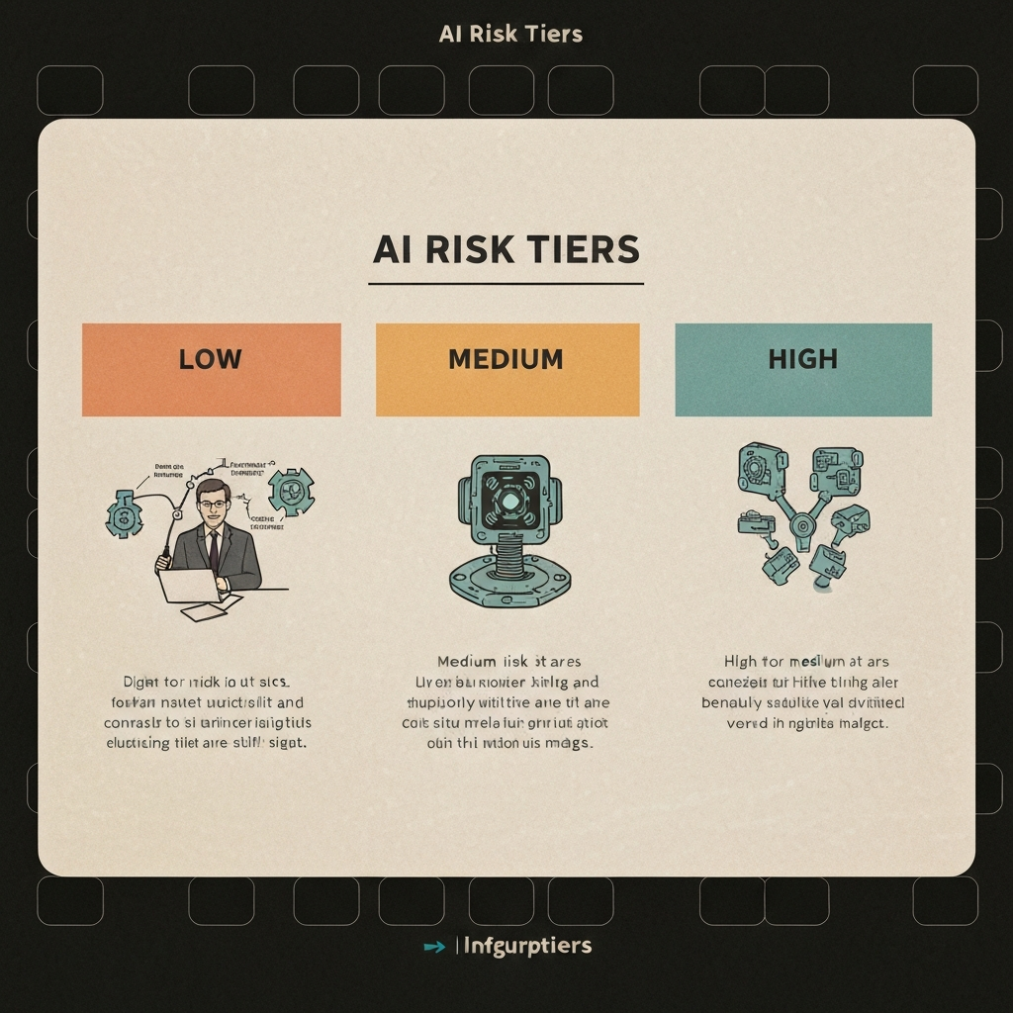
Risk Taxonomy and Examples
The presentation categorizes AI systems into four distinct risk tiers, ranging from 'Unacceptable Risk' to 'Minimal Risk'. This comprehensive taxonomy provides clear guidelines on the appropriate level of regulation and oversight required for different types of AI applications, ensuring responsible development and deployment of these powerful technologies.

Slide 6



Governance Operating Model
Organizational Structure
Three Lines of Defense
RACI for Key Decisions
The governance model includes several key roles and cross-functional committees: Board/Risk Committee, Executive Sponsor, AI Risk Committee, Model Risk Management (MRM), Data Protection/Privacy, Business Owners, and AI Ops/SRE.
The governance model follows a three-lines-of-defense approach: 1) First line - Product, Engineering, and Operations own the controls, 2) Second line - Risk, Compliance, and Privacy set the policies and review/challenge the first line, 3) Third line - Internal Audit independently assures the effectiveness of the controls.
The presentation outlines the Responsible, Accountable, Consulted, and Informed (RACI) matrix for three key decisions: 1) Classifying the use-case risk, 2) Approving high-risk deployments, and 3) Incident disclosure and notification.

Slide 7







Data/ML Lifecycle Controls
Data Sourcing Controls
Development Pipeline Security
Adversarial Evaluation
Deployment Monitoring

Slide 8




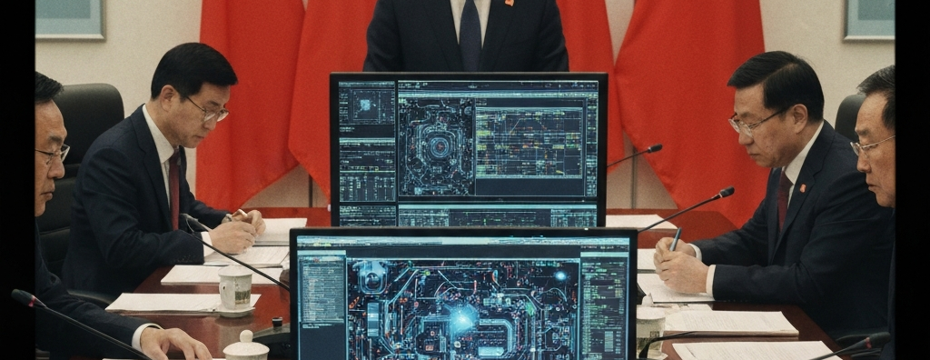
Enforcement Caselets
FTC Enforcement Action Against Retail Facial Recognition
Italy's Garante Targets Transparency in Large Language Models
New York City Enforces Bias Audits for Hiring AI
UK ICO Tackles Biometric AI Deployments
China Enforces Content Controls for Generative AI
The FTC took enforcement action against a retail company's use of facial recognition technology, citing harms related to accuracy, false positives, and inadequate controls.
The Italian data protection authority, Garante, took action against a large language model (LLM) provider regarding transparency, age-gating, and data rights.
The New York City Department of Consumer and Worker Protection (DCWP) enforced bias audit and candidate disclosure requirements for automated employment decision tools.
The UK's Information Commissioner's Office (ICO) took enforcement action against the use of facial recognition and web-scraped biometrics, issuing orders and fines under data protection laws.
China's Cyberspace Administration (CAC) implemented requirements for generative and deep synthesis services, mandating labeling, security reviews, and filings before and after launch.

Slide 9

In summary, the global landscape of AI regulation has evolved significantly from 2016 to 2025, with key milestones and differing approaches across the four regions. Developers, providers, and deployers of AI systems must navigate a complex web of obligations and risk tiers. Comprehensive governance and controls are essential to ensure responsible AI deployment. Moving forward, continued collaboration and harmonization will be critical to address emerging AI risks and foster innovation.

